Slide 1
Dynamic Programming

Slide 2
BASICS OF DYNAMIC PROGRAMMING
Useful for solving multistage optimization problems.
An optimization problem deals with the maximization or minimization of the objective function as per problem requirements.
In multistage optimization problems, decisions are made at successive stages to obtain a global solution for the given problem.
Dynamic programming divides a problem into subproblems and establishes a recursive relationship between the original problem and its subproblems.

Slide 3
BASICS OF DYNAMIC PROGRAMMING-cont’d
A subproblem representing a small part of the original problem is solved to obtain the optimal solution.
Then the scope of this subproblem is enlarged to find the optimal solution for a new subproblem.
This enlargement process is repeated until the subproblem’s scope encompasses the original problem.
After that, a solution for the whole problem is obtained by combining the optimal solutions of its subproblems.

Slide 4
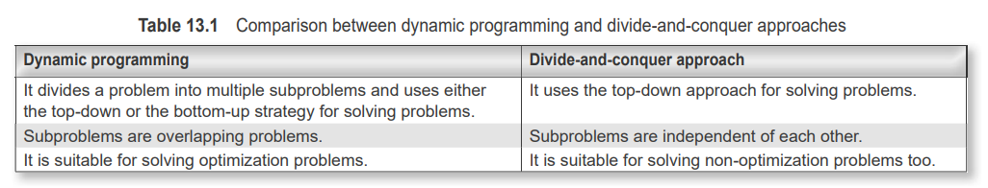
Dynamic programming vs divide-and-conquer approaches
The difference between dynamic programming and the top-down or divide-and-conquer approach is that the subproblems overlap in the dynamic programming approach. In contrast, in the divide-and-conquer approach, the subproblems are independent. The differences between the dynamic programming and divide-and-conquer approaches.

Slide 5
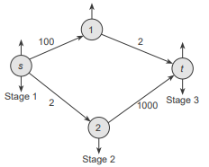
Dynamic programming approach vs greedy approach
Dynamic programming can also be compared with the greedy approach.
Unlike dynamic programming, the greedy approach fails in many problems.
consider the shortest-path problem for the distance between s and t in the graph shown in Fig. A greedy algorithm such as Dijkstra would take the route from s to vertex 2, as its path length is shorter than that of the route from s to ‘1’.
After that, the path length increases, resulting in a total path length of 1002.
However, dynamic programming would not make such a mistake, as it treats the problem in stages.
For this problem, there are three stages with vertices {s}, {1, 2}, and {t}. The problem would find the shortest path from stage 2, {1, 2}, to {t} first, then calculate the final path. Hence, dynamic programming would result in a path s to 1 and from 1 to t.
Dynamic programming problems, therefore, yield a globally optimal result compared to the greedy approach, whose solutions are just locally optimal.

Slide 6
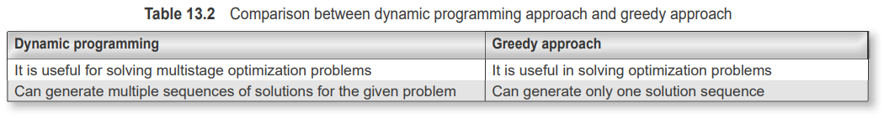
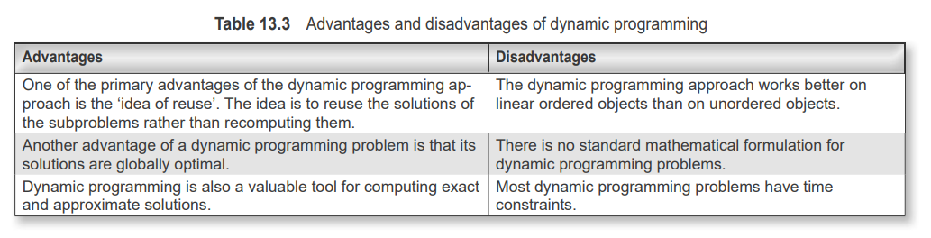
Dynamic programming approach vs greedy approach
Advantages and Disadvantages of dynamic programming

Slide 7
Components of Dynamic Programming
The guiding principle of dynamic programming is the ‘principle of optimality’. In simple words, a given problem is split into subproblems.
Then, this principle helps us solve each subproblem optimally, ultimately leading to the optimal solution of the given problem. It states that an optimal sequence of decisions in a multistage decision problem is feasible if its sub-sequences are optimal.
In other words, the Bellman principle of optimality states that “an optimal policy (a sequence of decisions) has the property that whatever the initial state and decision are, the remaining decisions must constitute an optimal policy concerning the state resulting from the first decision”.
The solution to a problem can be achieved by breaking the problem into subproblems. The subproblems can then be solved optimally. If so, the original problem can be solved optimally by combining the optimal solutions of its subproblems.

Slide 8
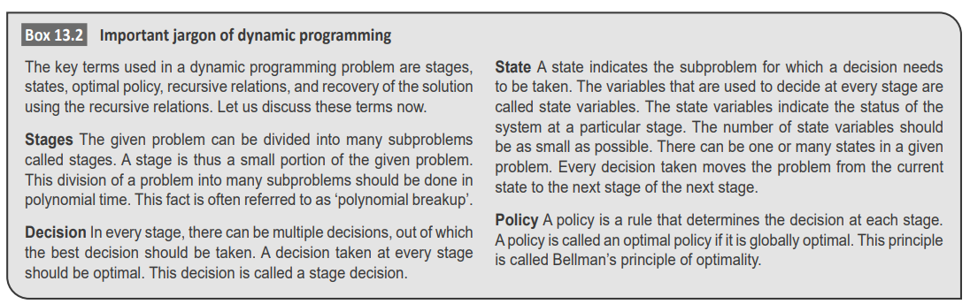
Components of Dynamic Programming

Slide 9
overlapping subproblems
Dynamic programs possess two essential properties—
overlapping subproblems
optimal substructures.
Overlapping subproblems One of the main characteristics of dynamic programming is to split the problem into subproblems, similar to the divide-and-conquer approach. The sub-problems are further divided into smaller problems. However, unlike divide and conquer, here, many subproblems overlap and cannot be treated distinctly.
This feature is the primary characteristic of dynamic programming. There are two ways of handling this overlapping problem:
The memoization technique
The tabulation method.

Slide 10
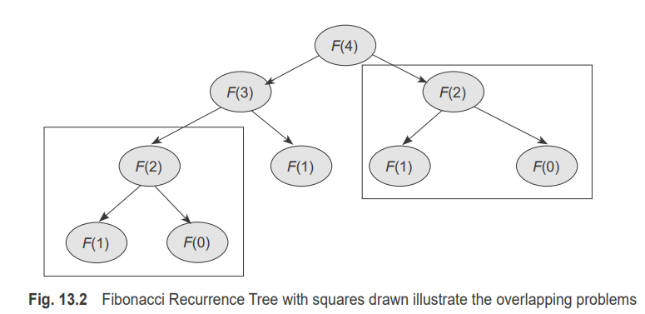
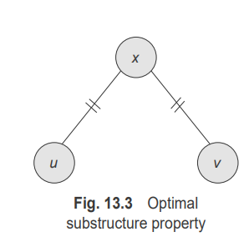
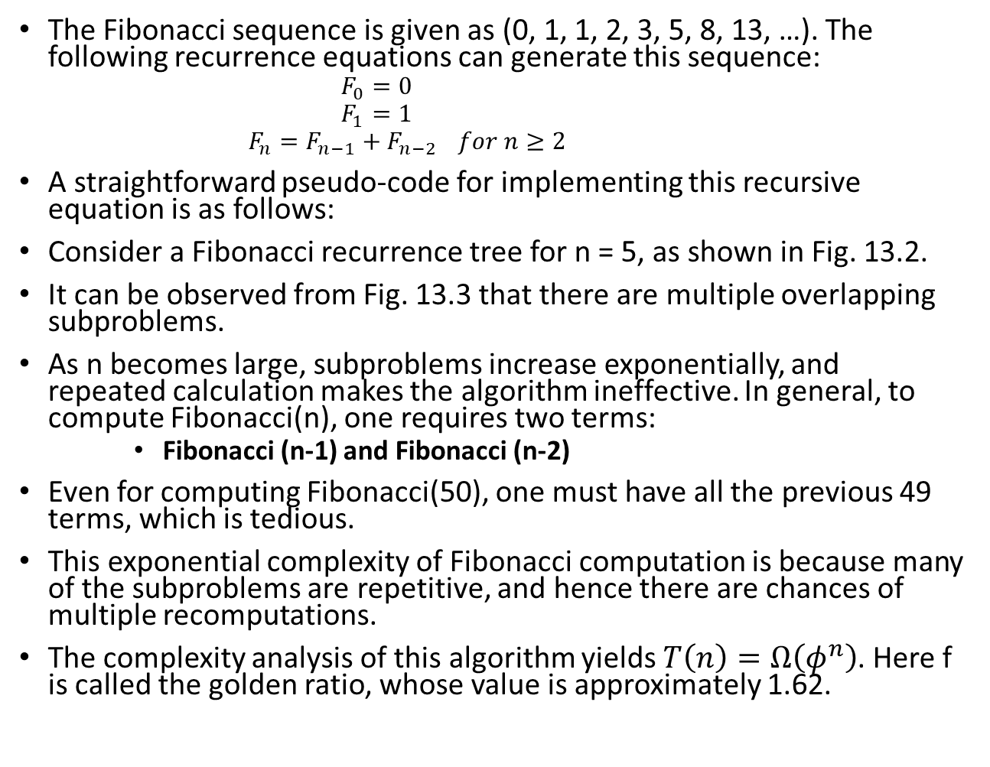
overlapping subproblems
The Fibonacci sequence is given as (0, 1, 1, 2, 3, 5, 8, 13, …). The following recurrence equations can generate this sequence:
$$F_{0}=0$$
$$F_{1}=1$$
$$F_{n}=F_{n−1}+F_{n−2 } for n≥2$$
A straightforward pseudo-code for implementing this recursive equation is as follows:
Consider a Fibonacci recurrence tree for n = 5, as shown in Fig. 13.2.
It can be observed from Fig. 13.3 that there are multiple overlapping subproblems.
As n becomes large, subproblems increase exponentially, and repeated calculation makes the algorithm ineffective. In general, to compute Fibonacci(n), one requires two terms:
Fibonacci (n-1) and Fibonacci (n-2)
Even for computing Fibonacci(50), one must have all the previous 49 terms, which is tedious.
This exponential complexity of Fibonacci computation is because many of the subproblems are repetitive, and hence there are chances of multiple recomputations.
The complexity analysis of this algorithm yields $T\left(n\right)=Ω\left(φ^{n}\right)$. Here f is called the golden ratio, whose value is approximately 1.62.

Slide 11
Optimal substructure
The optimal solution of a problem can be expressed in terms of optimal solutions to its subproblems.
In dynamic programming, a problem can be divided into subproblems. Then, the subproblem can be solved sub optimally. If so, the optimal solutions of the subproblems can lead to the optimal solution of the original problem.
If the solution to the original problem has stages, then the decision taken at the current stage depends on the decision taken in the previous stages.
Therefore, there is no need to consider all possible decisions and their consequences as the optimal solution of the given problem is built on the optimal solution of its subproblems

Slide 12
Optimal substructure
Consider the graph shown in Fig. 13.3. Consider the best route to visit the city v from city u.
This problem can be broken into a problem of finding a route from u to x and from x to v. If <u, x> is the optimal route from u to x, and the best route from x to v is <x, v>, then the best route from u to v can be built on the optimal solutions of its two subproblems. In other words, the route constructed on the suboptimal optimal routes must also be optimal.
The general template for solving dynamic programming looks like this:
Step 1: The given problem is divided into many subproblems, as in the case of the divide-and-conquer strategy. In divide and conquer, the subproblems are independent of each other; however, in the dynamic programming case, the subproblems are not independent of each other, but they are interrelated and hence are overlapping subproblems.

Slide 13
Optimal substructure
Step 2: A table is created to avoid the recomputation of multiple overlapping subproblems repeatedly; a table is created. Whenever a subproblem is solved, its solution is stored in the table, so that its solutions can be reused.
Step 3.The solutions of the subproblems are combined in a bottom-up manner to obtain the final solution of the given problem
The essential steps are thus:
1. It is breaking the problems into its subproblems.
2. Creating a lookup table that contains the solutions of the subproblems.
3. Reuse the solutions of the subproblems stored in the table to construct solutions to the given problem.

Slide 14
Optimal substructure
Dynamic programming uses the lookup table in both a top-down manner and a bottom-up manner. The top-down approach is called the memorization technique, and the bottom-up manner is called the tabulation method.
1. Memoization technique: This method looks into a table to check whether the table has any entries. The lookup table Contains entries such as ‘NIL’ or ‘undefined’. If no value is present, then it is computed. Otherwise, the pre-computed value is reused. In other words, computation follows a top-down method similar to the recursion approach.
2. Tabulation method: Here, the problem is solved from scratch. The smallest subproblem is solved, and its value is stored in the table. Its value is used later for solving larger problems. In other words, computation follows a bottom-up method.

Slide 15
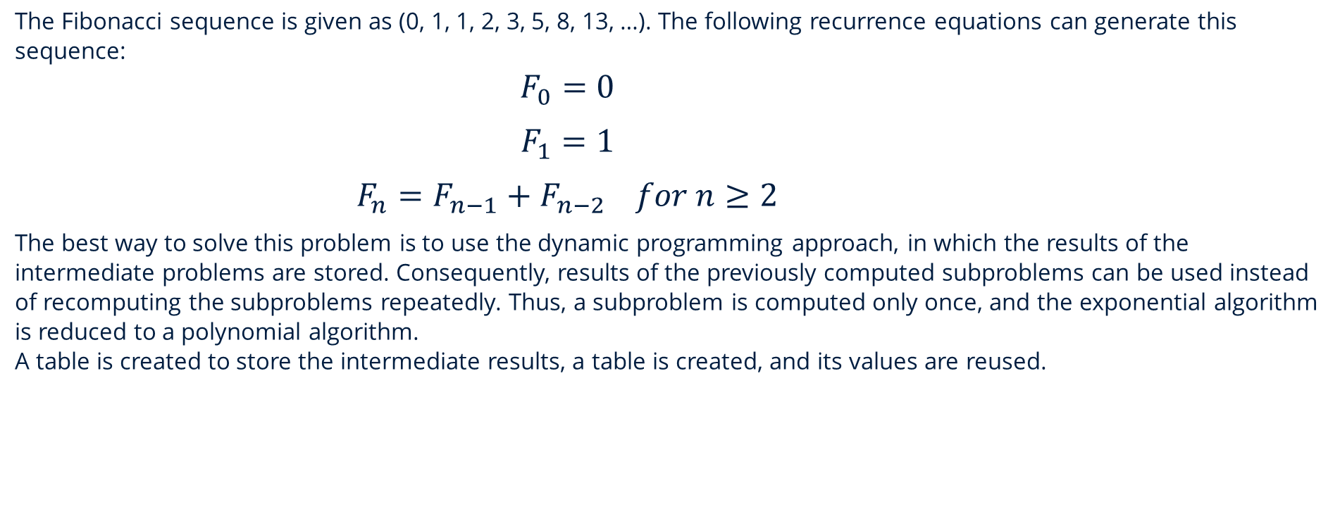
FIBONACCI PROBLEM
The Fibonacci sequence is given as (0, 1, 1, 2, 3, 5, 8, 13, …). The following recurrence equations can generate this sequence:
$$F_{0}=0$$
$$F_{1}=1$$
$$F_{n}=F_{n−1}+F_{n−2 } for n≥2$$
The best way to solve this problem is to use the dynamic programming approach, in which the results of the intermediate problems are stored. Consequently, results of the previously computed subproblems can be used instead of recomputing the subproblems repeatedly. Thus, a subproblem is computed only once, and the exponential algorithm is reduced to a polynomial algorithm.
A table is created to store the intermediate results, a table is created, and its values are reused.

Slide 16

Bottom-up approach
An iterative loop can be used to modify this Fibonacci number computation effectively, and the resulting dynamic programming algorithm can be used to compute the n^{th} Fibonacci number.
Step 1: Read a positive integer n.
Step 2: Initialize first to 0.
Step 3: Initialize second to 1.
Step 4: Repeat n − 1 times.
4a: Compute current as first + second.
4b: Update first = second.
4c: Update second = current.
Step 5: Return(current).
Step 6: End.

Slide 17
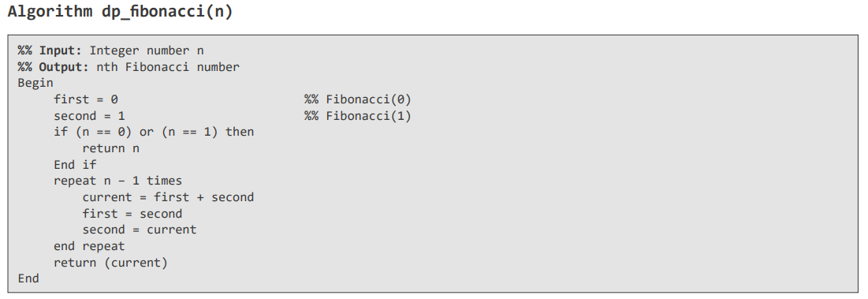
Fibonacci Algorithm using dynamic programming

Slide 18
Top-down approach and Memoization
Dynamic programming can use the top-down approach for populating and manipulating the table.
Step 1: Read a positive integer n
Step 2: Create a table A with n entries
Step 3: Initialize table A with the status ‘undefined.’
Step 4: If the table entry is ‘undefined.’
4a: Compute recursively
mem_Fib(n) = mem_Fib(n − 1) + mem_Fib(n − 2)
else
return table value
Step 5: Return(mem_Fibonacci(A, n))

Slide 19
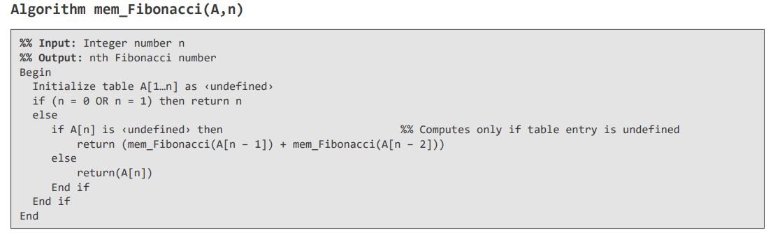
Memoization technique algorithm

Slide 20
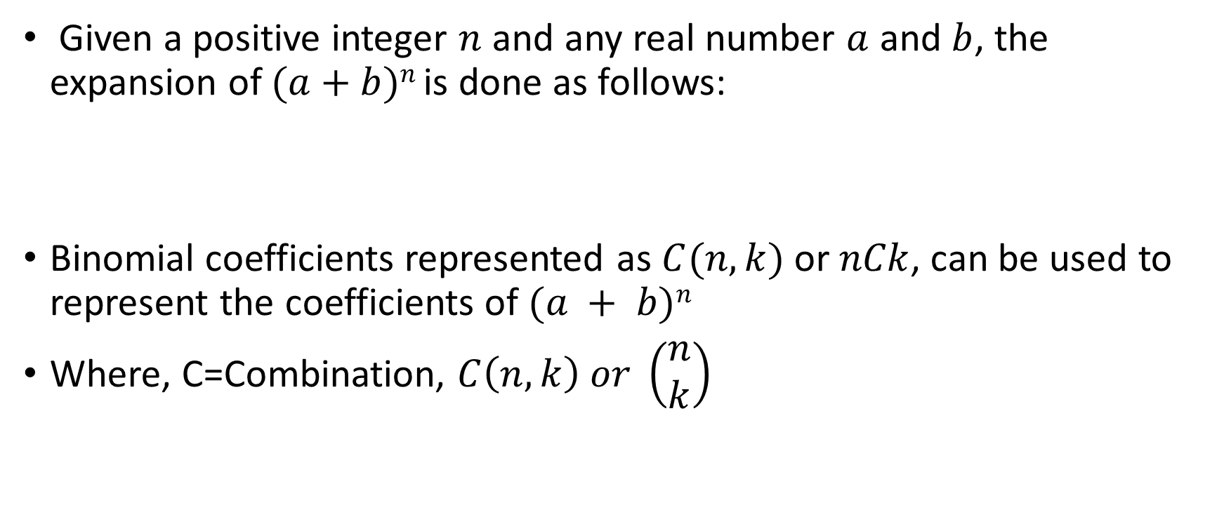
COMPUTING BINOMIAL COEFFICIENTS
Given a positive integer $n$ and any real number $a$ and $b$, the expansion of $(a+b)n$is done as follows:
Binomial coefficients represented as $C(n, k)$or $nCk$, can be used to represent the coefficients of $(a + b)n$
Where, C=Combination, $C\left(n,k\right) or \left(\begin{matrix}n \\ k\end{matrix}\right)$

Slide 21
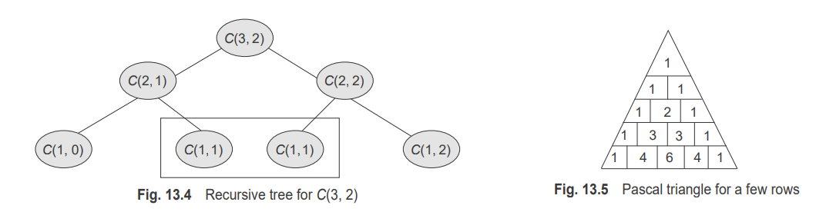
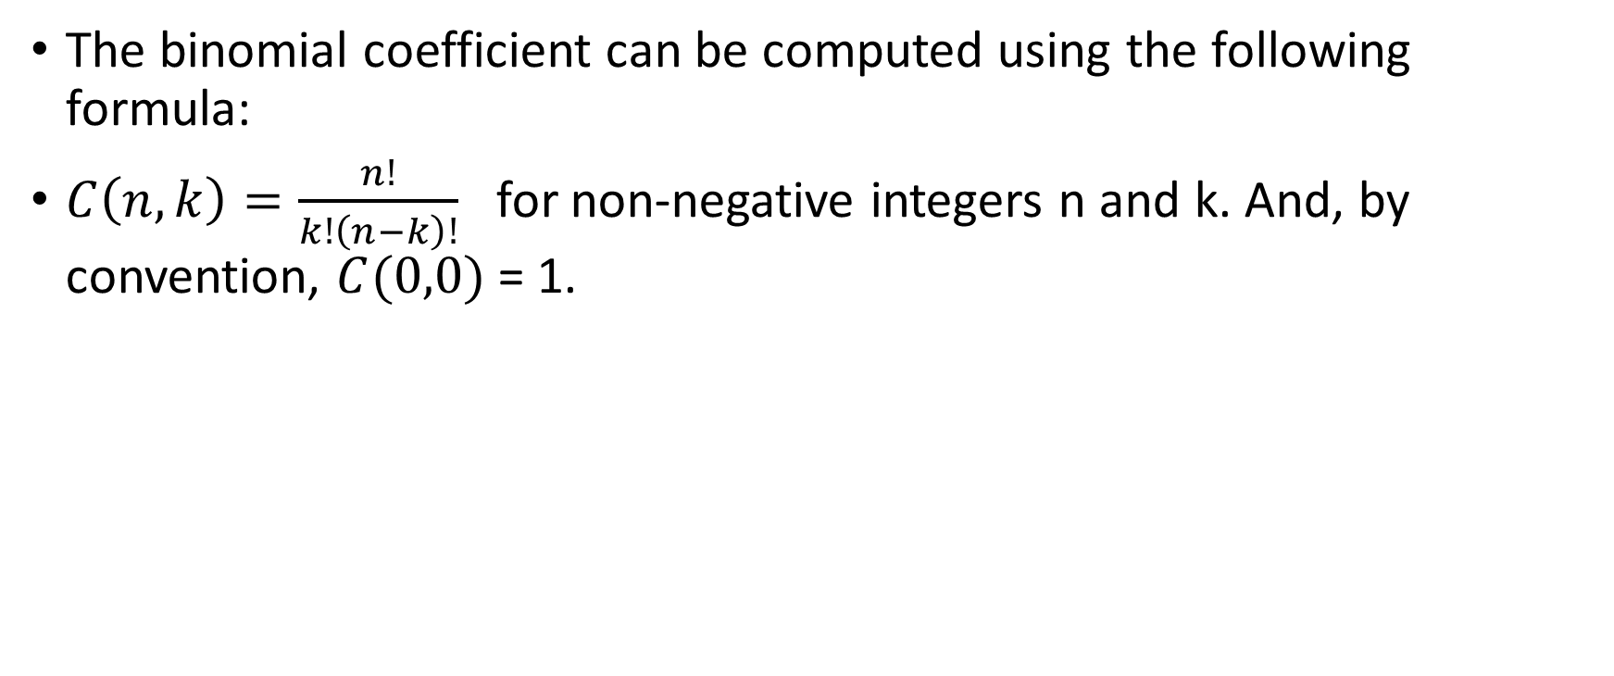
COMPUTING BINOMIAL COEFFICIENTS
The binomial coefficient can be computed using the following formula:
$C\left(n,k\right)=\frac{n!}{k!\left(n−k\right)!}$ for non-negative integers n and k. And, by convention, $C(0,0)$= 1.

Slide 22
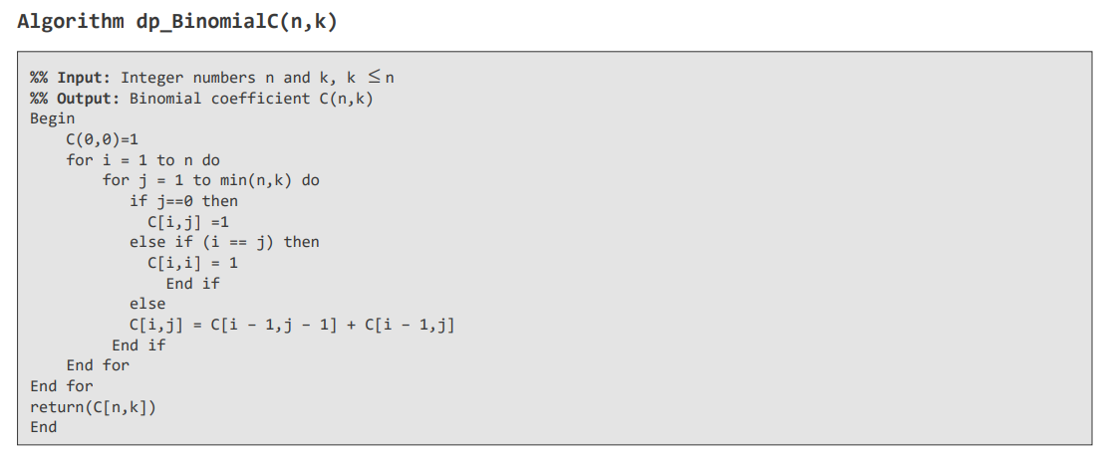
Computing binomial coefficients Algorithm
The complexity analysis of this algorithm can be observed as O(n, k).

Slide 23
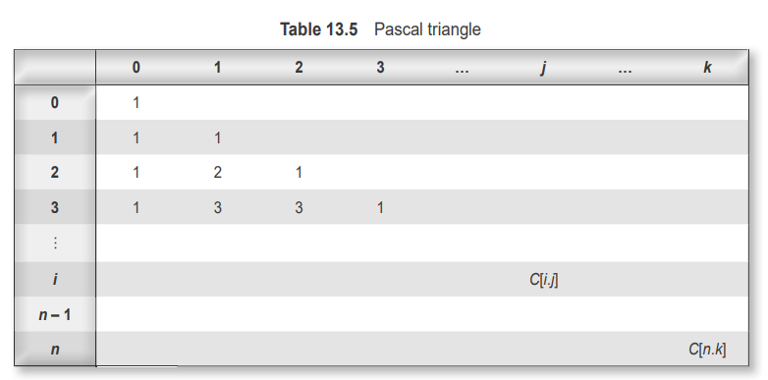
Pascal Triangle

Slide 24
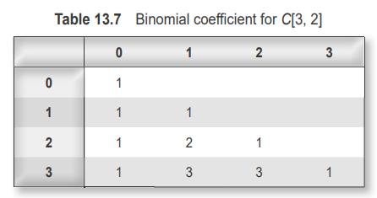
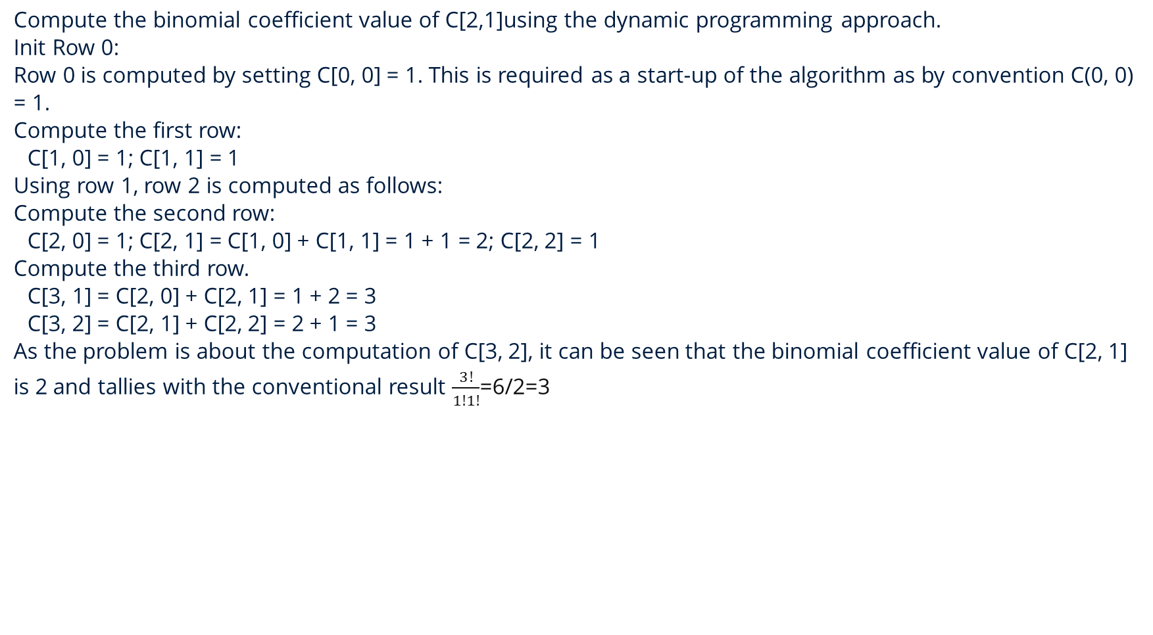
Compute the binomial coefficient value of C[2,1]using the dynamic programming approach.
Init Row 0:
Row 0 is computed by setting C[0, 0] = 1. This is required as a start-up of the algorithm as by convention C(0, 0) = 1.
Compute the first row:
C[1, 0] = 1; C[1, 1] = 1
Using row 1, row 2 is computed as follows:
Compute the second row:
C[2, 0] = 1; C[2, 1] = C[1, 0] + C[1, 1] = 1 + 1 = 2; C[2, 2] = 1
Compute the third row.
C[3, 1] = C[2, 0] + C[2, 1] = 1 + 2 = 3
C[3, 2] = C[2, 1] + C[2, 2] = 2 + 1 = 3
As the problem is about the computation of C[3, 2], it can be seen that the binomial coefficient value of C[2, 1] is 2 and tallies with the conventional result $\frac{3!}{1!1!}$=6/2=3

Slide 25
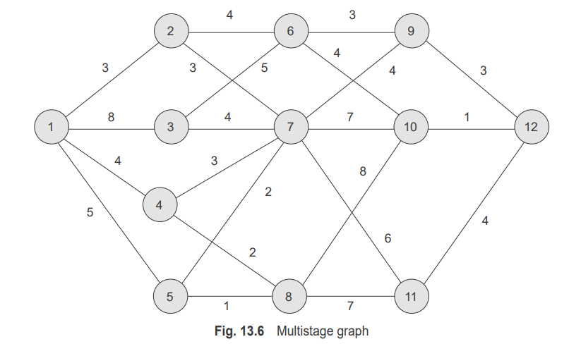
MULTISTAGE GRAPH PROBLEM (stagecoach problem)
The multistage problem is a problem of finding the shortest path from the source to the destination. Every edge connects two nodes from two partitions. The initial node is called a source (No indegree), and the last node is called a sink (as there is no outdegree).

Slide 26
Forward computation procedure
Step 1: Read directed graph G = <V, E> with k stages.
Step 2: Let n be the number of nodes and dist[1… k] be the distance array.
Step 3: Set the initial cost to zero.
Step 4: Loop index i from (n − 1) to 1.
4a: Find a vertex v from the next stage such that the edge connecting the current stage and the next stage is minimum (j, v) + cost(v) is minimum.
4b: Update cost and store v in another array dist[].
Step 5: Return cost.
Step 6: End.
The shortest path can finally be obtained or reconstructed by tracking the distance array

Slide 27
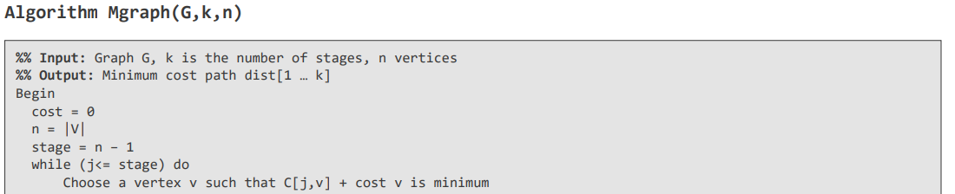
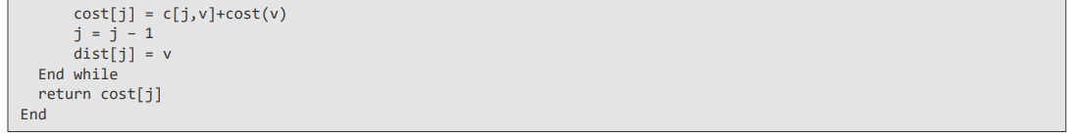
MULTISTAGE GRAPH Algorithm

Slide 28
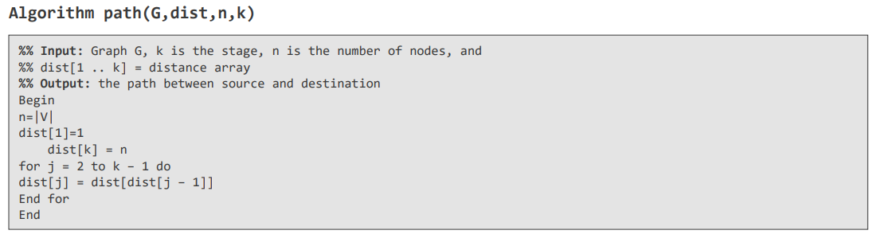
MULTISTAGE GRAPH Algorithm

Slide 29
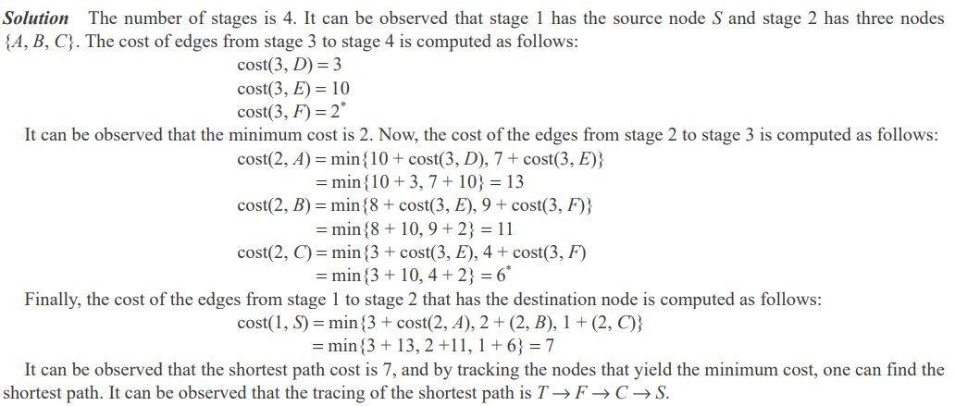
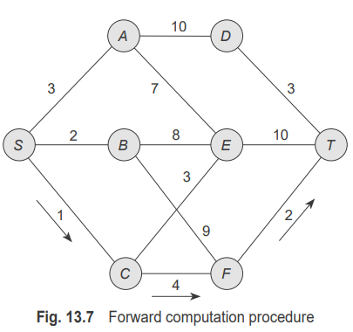
Consider the graph shown in Fig. 13.7. Find the shortest path from the source to the sink using the forward approach of dynamic programming.

Slide 30
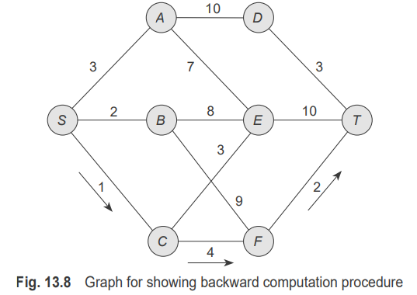
Backward computation procedure
Consider the graph shown in Fig. 13.8. Find the shortest path from the source to the sink using the backward approach of dynamic programming.
Unlike the forward approach, the computation starts from stage 1 to stage 5. The cost of the edges that connect Stage 2 to Stage 1 is calculated.

Slide 31
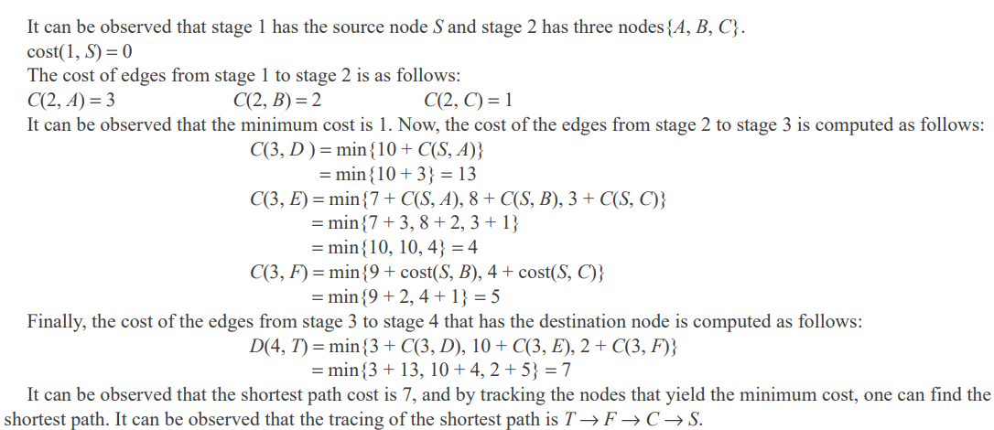

Slide 32
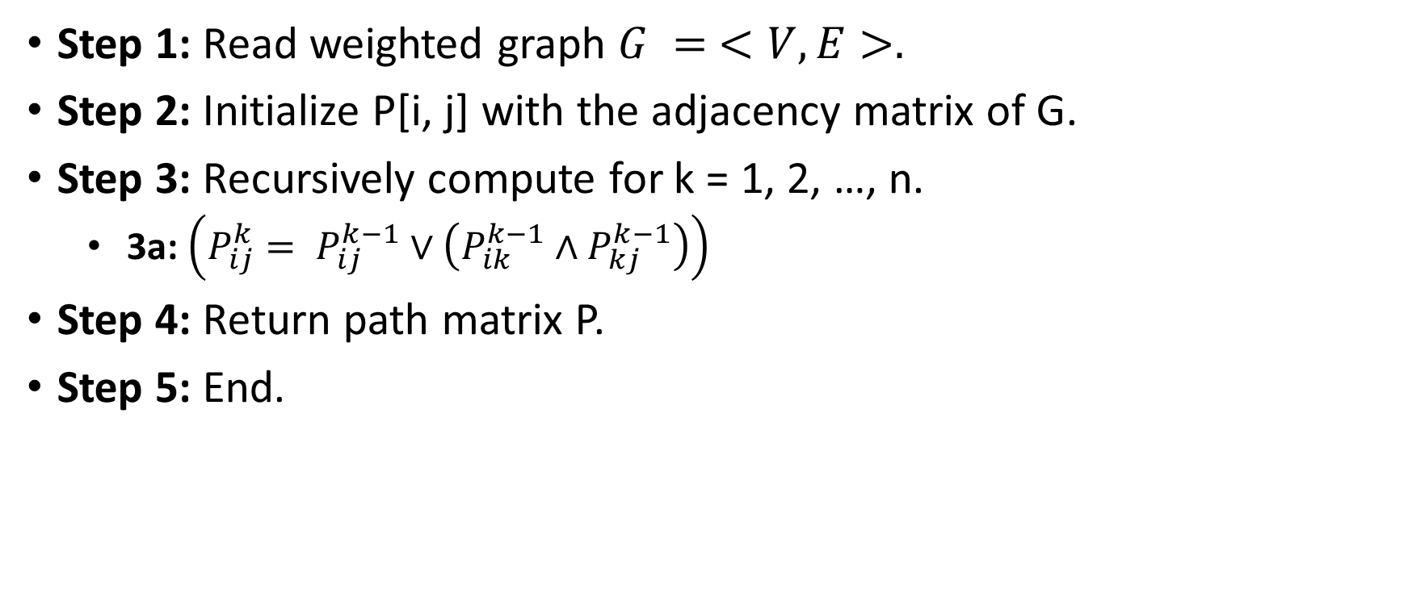
TRANSITIVE CLOSURE AND WARSHELL ALGORITHM
Step 1: Read weighted graph $G = <V, E>.$
Step 2: Initialize P[i, j] with the adjacency matrix of G.
Step 3: Recursively compute for k = 1, 2, …, n.
3a: $\left(P_{ij}^{k}= P_{ij}^{k−1}∨\left(P_{ik}^{k−1}∧P_{kj}^{k−1}\right)\right)$
Step 4: Return path matrix P.
Step 5: End.

Slide 33
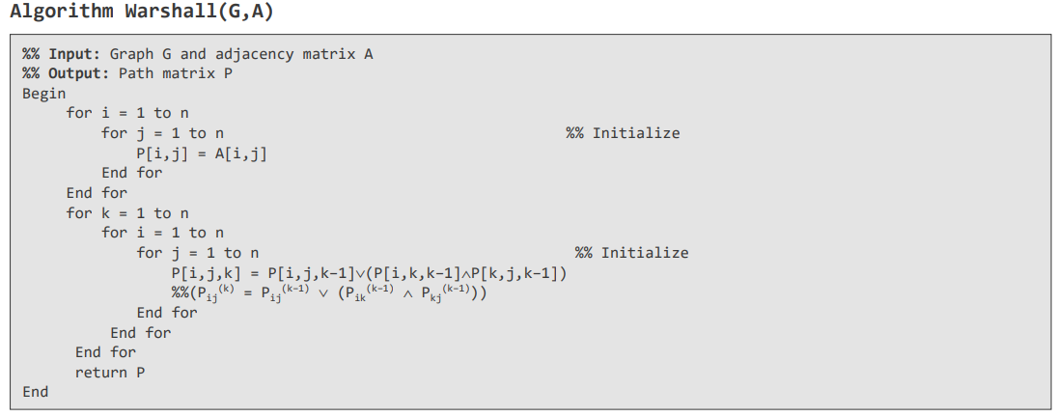
Warshall Algorithm

Slide 34
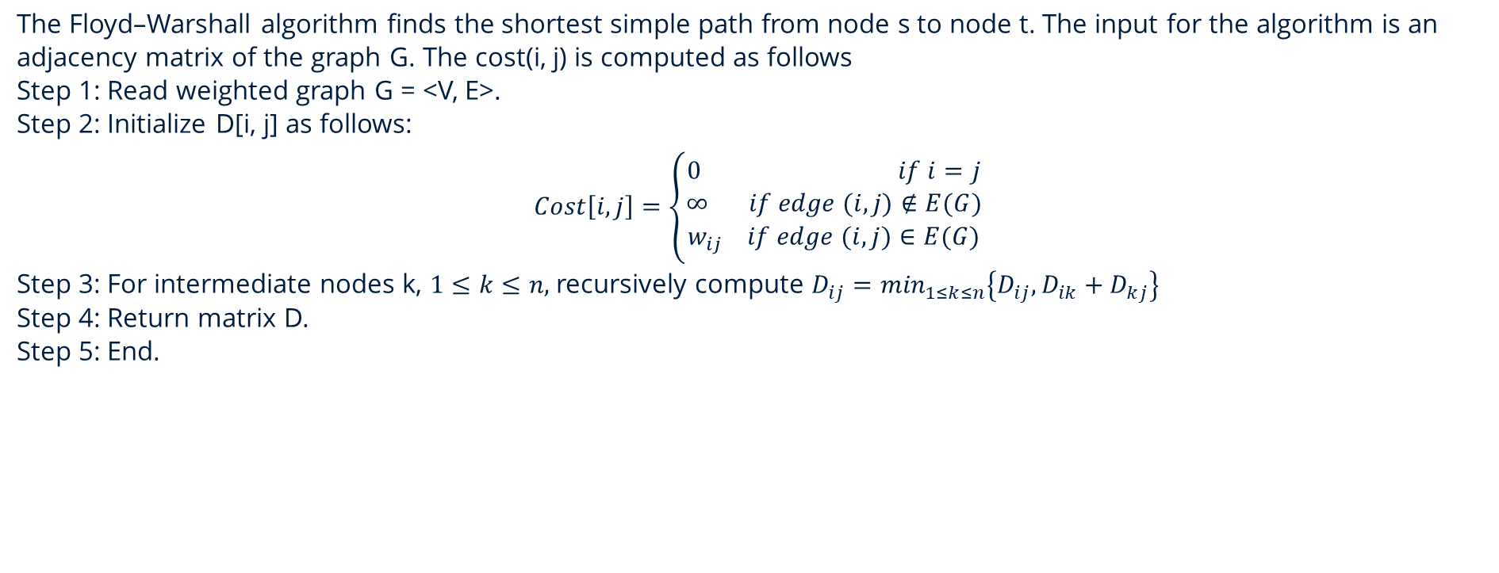
Floyd-Warshall all-pairs shortest algorithm
The Floyd–Warshall algorithm finds the shortest simple path from node s to node t. The input for the algorithm is an adjacency matrix of the graph G. The cost(i, j) is computed as follows
Step 1: Read weighted graph G = <V, E>.
Step 2: Initialize D[i, j] as follows:
$$Cost\left[i,j\right]=\left\{\begin{aligned}0 if i=j \\ ∞ if edge (i,j)∉E(G) \\ w_{ij} if edge (i,j)∈E(G)\end{aligned}\right.$$
Step 3: For intermediate nodes k, $1≤k≤n,$ recursively compute $D_{ij}=\min_{1≤k≤n}\left\{D_{ij},D_{ik}+D_{kj}\right\}$
Step 4: Return matrix D.
Step 5: End.

Slide 35
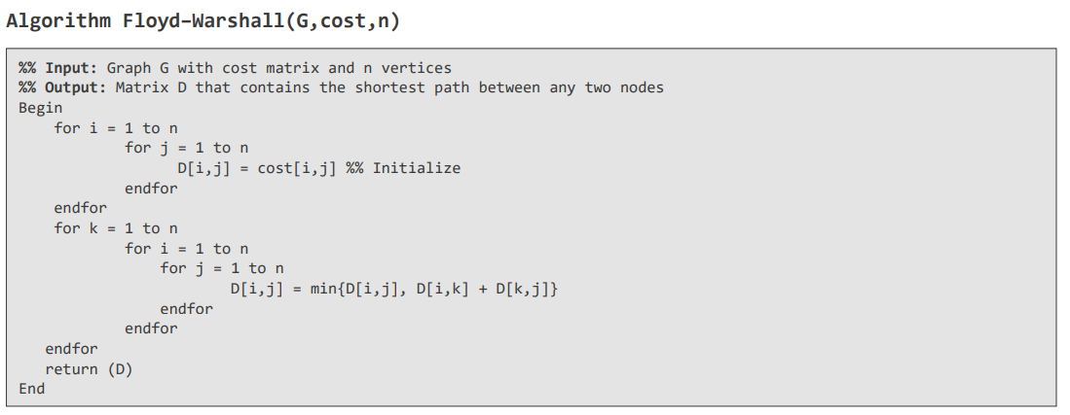
Floyd-Warshall all-pairs shortest algorithm

Slide 36
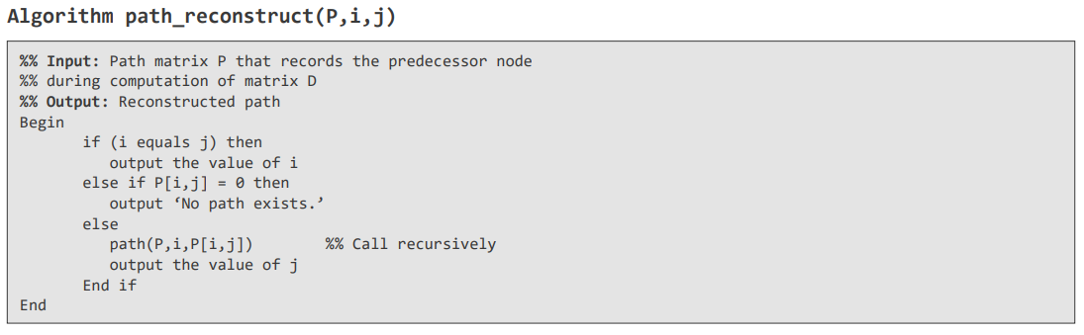
Floyd-Warshall all-pairs shortest algorithm

Slide 37
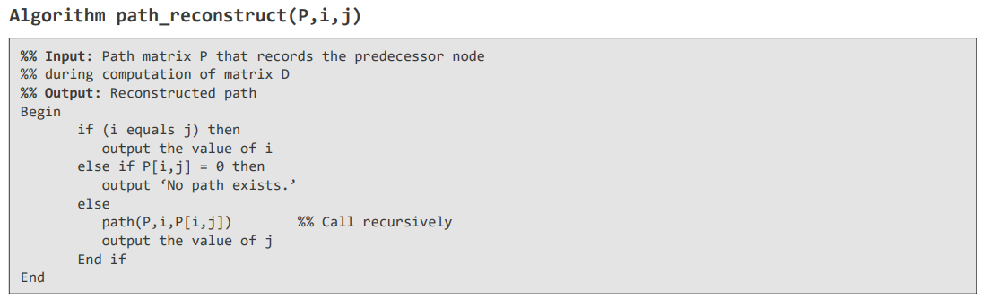
Floyd-Warshall all-pairs shortest algorithm

Slide 38
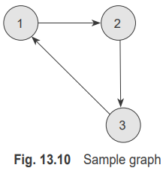
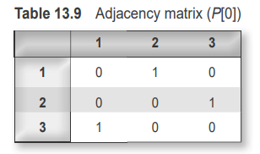
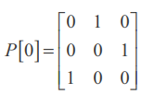
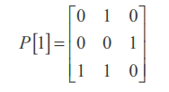

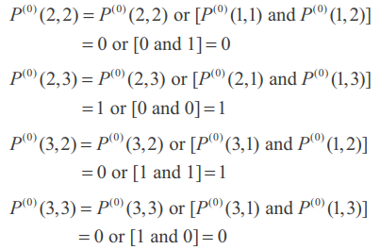
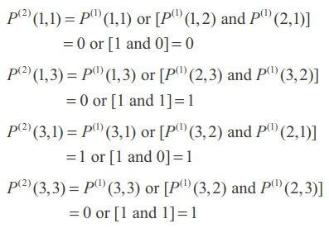
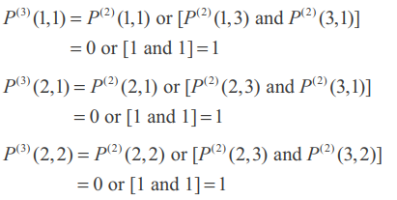

Apply the Warshall algorithm and find the transitive closure for the graph shown in Fig. 13.10.

Slide 39
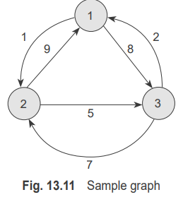
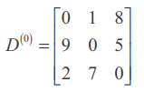

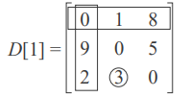

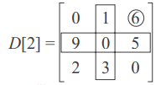
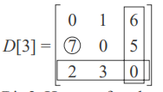

Consider the graph shown in Fig. 13.11 and find the shortest path using the Floyd–Warshall algorithm.

Slide 40
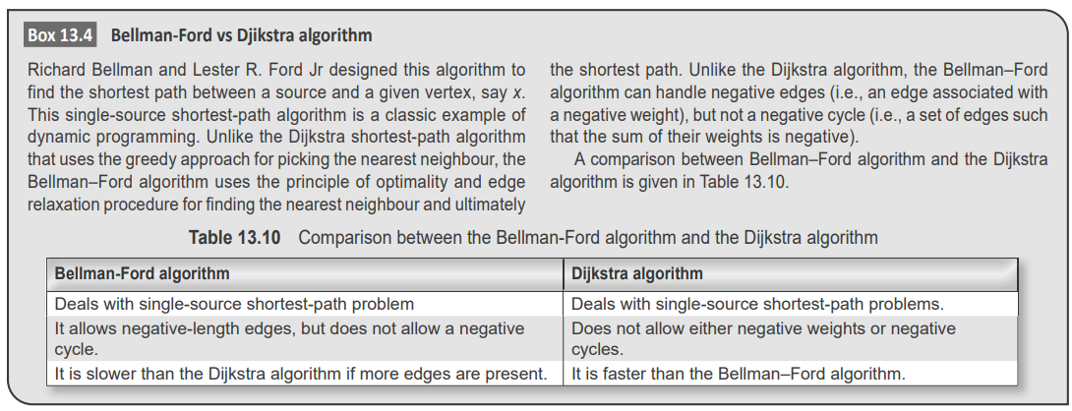
Bellman-Ford Algorithm

Slide 41
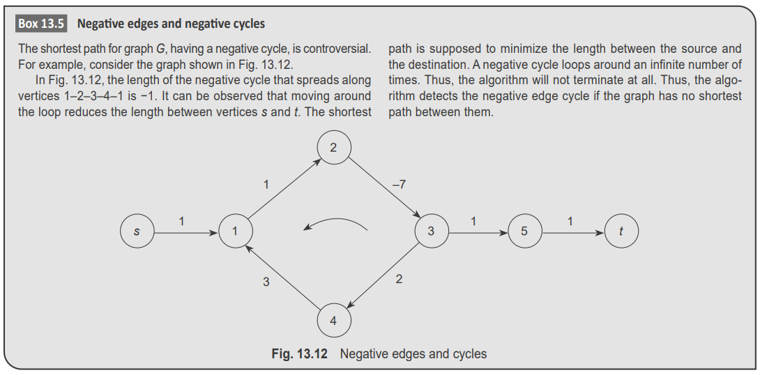
Bellman-Ford Algorithm

Slide 42

Bellman-Ford Algorithm
Step 1: Choose the source vertex and label it ‘0’.
Step 2:Label all vertices except the source as $∞$.
Step 3: Repeat n – 1 times, where n is the number of vertices.
3a: If the label of v is larger than that of u + cost of the edge (u, v) then relax on edge.
3b: Update the label of v as the label of u + cost of the edge (u, v).
Step 4: Check the presence of any negative edge cycle by repeating the iteration and carrying out the procedure if any
edges still relax. If so, report the presence of a negative weight cycle.
Step 5: Exit

Slide 43
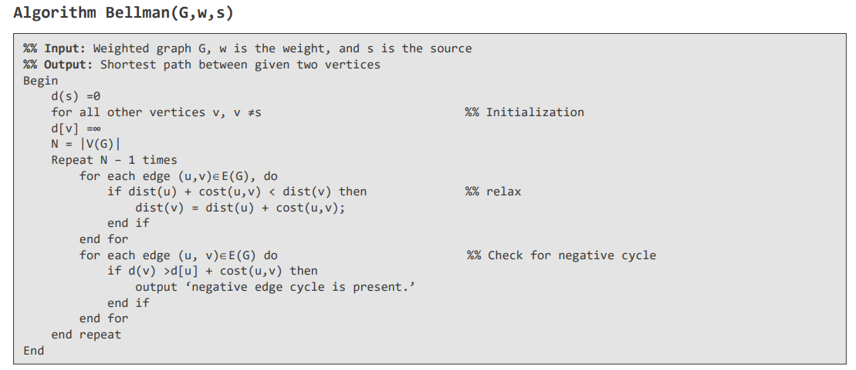
Bellman-Ford Algorithm

Slide 44
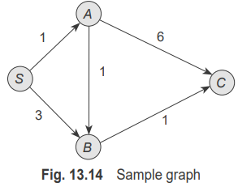
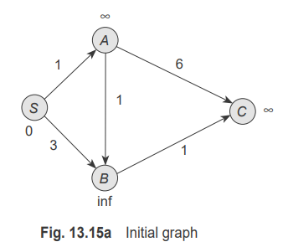




Apply the Bellman–Ford algorithm to the graph shown in Fig. 13.14.

Slide 45





Slide 46

Travelling salesman problem
Step 1: Read weighted graph G = <V, E>.
Step 2: Initialize d[i, j] as follows:
$$d\left[i,j\right]=\left\{\begin{aligned}0 if i=j \\ ∞ if edge (i,j)∉E(G) \\ w_{ij} if edge (i,j)∈E(G)\end{aligned}\right.$$
Step 3: Compute a function g(i, S), a function that gives the length of the shortest path starting from vertex i, traversing through all the vertices in set S, and terminating at vertex i as follows:
3a: $cost\left(i,φ\right)=d\left[i,1\right], 1≤i≤n$
3b: For |S| = 2 to n − 1, where, $i≠1, 1∉S, i∉S$ compute recursively $cost(S.i) \min_{j∈S}\{cost[i, j], S − \{j\}\}$ and store the value.
Step 4: Compute the minimum cost of the travelling salesperson tour as follows: Compute
$cost\left(1,v−\{1\}\right)=min2≤i≤k\{d[1, k] + cost(k, v − \{1, k\}\} using g(i, S)$computed in Step 3.
Step 5: Return the value of Step 4.
Step 6: End.

Slide 47

Travelling salesman problem
Solve the TSP for the graph shown in Fig. 13.17 using dynamic programming.
cost(2, ∅) = d[2, 1] = 2; cost(3, ∅) = d[3, 1] = 4; cost(4, ∅) = d[4, 1] = 6
This indicates the distance from vertices 2, 3, and 4 to vertex 1. When |S| = 1, cost(i, j) function can be solved using the recursive function as follows:
cost(2,{3}) = d[2, 3] + cost(3, ∅)=5+4=9
cost(2,{4}) = d[2, 4] + cost(4, ∅) = 7 + 6 = 13
cost(3,{2}) = d[3, 2] + cost(2, ∅) =3+2=5
cost(3,{4}) = d[3, 4] + cost(4, ∅) = 8 + 6 = 14
cost(4,{2}) = d[4, 2] + cost(2, ∅) =5+2=7
cost(4,{3}) = d[4, 3] + cost(3, ∅) = 9 + 4 = 13

Slide 48
Now, cost(S, i) is computed with |S| = 2, i ≠ 1, 1 ∉S, i ∉n, that is, set S involves two intermediate nodes.
cost(2,{3,4}) = min{d[2, 3] + cost(3, {4}), d[2, 4] + cost(4, {3})} = min{5 + 14 , 7 + 13} = min{19, 20} = 19
cost(3,{2,4}) = min{d[3, 2] + cost(2, {4}), dist[3, 4]+cost(4, {2})} = min{3 + 13, 8 + 7} = min{16, 15} = 15
cost(4,{2,3}) = min{d[4, 2] + cost(2, {3}), d[4, 3] + cost(3, {2})} = min{5 + 9, 9 + 5} = min{14, 14} = 14
Finally, the total cost of the tour is calculated, which involves three intermediate nodes, that is, |S| = 3. As |S| = n − 1, where n is the number of nodes, the process terminates.
Finally, using the equation, cost(1, v − {1}) = 〖min〗_(2≤i≤k) {dist[1, k] + cost(k, v − {1, k}}, cost of the tour [cost(1, {2, 3, 4})] is computed as follows:
cost(1,{2, 3, 4}) = min{d[1, 2] + cost(2,{3, 4}), d[1, 3] + cost(3, {2, 4}),d[1, 4] + cost(4, {2, 3})} = min{5 + 19, 3 + 15, 10 + 14} = min {24,18, 24} = 18
Hence, the minimum cost tour is 18. Therefore, P(1, {2, 3, 4}) = 3, as the minimum cost obtained is only 18. Thus, the tour goes from 1→3. It can be seen that C(3, {2, 4}) is minimum and the successor of node 3 is 4. Hence, the path is 1 → 3 → 4, and the final TSP tour is given as 1 → 3 → 4 → 2 → 1.

Slide 49

Chain Matrix Multiplication
Step 1: Read n chain of matrices $<A1, A2, …, An>$with dimensions $p0, p1, …, pn.$
Step 2: Let i and j represent the start and end matrices, and let M[i, j] represent the minimum matrix multiplication required to compute $Ai,j$.
Step 3: Compute recursively.
3a: If (i = j), then M[i, j] = 0
else
if (i < j), then
split the matrix A_{1…n} as A_{1…n} = A_{1…k} × A_{k+1…n,} Where, 1$≤k≤n−1$
compute $M[i, j] = \min_{j−1}\{M[i, k] + M[k + 1, j] + p_{i−1} pk pj\}$
Step 4: Return M[1, n] as the minimum cost of chain matrix multiplication.

Slide 50

Chain Matrix Multiplication
The extraction of the optimal order is explained as follows:
Step 1: Read the trace matrix R with minimum k, yielding the minimum cost.
Step 2: Perform recursive call as follows:
If (i≠j), then
k = R[i, j]
return $(mult(R_{1…k}) × mult(R_{k+1…n}))$
else
return(R(i, j)
Step 3: End.

Slide 51

Chain Matrix Multiplication

Slide 52


Chain Matrix Multiplication
Consider the following four matrices whose orders are given and perform chain matrix multiplication using the dynamic programming approach:

Slide 53






Slide 54




Slide 55

Knapsack Problem
Step 1: Let n be the number of objects.
Step 2: Let W be the capacity of the knapsack.
Step 3: Construct the matrix V [i, j] that stores items and their weights. Index i tracts the items added to the knapsack (i.e., 1 to n), and index j tracks the weights (i.e., 0 to W)
Step 4: Initialize V[0, j] = 0 if j≥0. This implies no profit if no item is in the knapsack.
Step 5: Recursively compute the following steps:
5a: Leave the object i if $wj > j$or $j − wi < 0$. This leaves the knapsack with the items $\{1, 2, …, i−1]$with profit $V\left[i−1,j\right].$
5b: Add the item i if $w_{j}≤j$ or $j − wi ≥ 0$. In this case, the addition of the items results in a profit max$\{V [i−1,j], Vi + V [i−1,j − wi])\}.$Here $Vi$ is the profit of the current item.
Step 6: Return the maximum profit of adding feasible items to the knapsack, V [1… n].
Step 7: End.

Slide 56

Knapsack Problem

Slide 57


Knapsack Problem
Apply the dynamic programming algorithm to the instance of the knapsack problem shown in Table 13.28. Assume that the knapsack capacity is w = 3.

Slide 58



Computation of first row:
V[1, 1] = max{V[1 − 1, 1], 1 + V[0, 0]} = max{V[0, 1], 1 + 0} = 1
V[1, 2] = max{V[0, 1], 1 + V[0, 1]} = 1
V[1, 3] = max{V[0, 1], 1 + V[0, 2]} = 1
Computation of second row:
V[2, 1] = 1
V[2, 2] = max{V[1, 1], 6 + V[1, 0]} = 6
V[2, 3] = max{V[1, 1], 6 + V[1, 1]} = 7
Computation of third row
V[3, 1] = V[2, 1] = 1
V[3, 2] = V[2, 2] = 6
V[3, 3] = V[2, 3] = 7

Slide 59

Optimal Binary Search Trees
1. Each node of a BST has one key.
2. All the nodes on the LHS of a BST are less than or equal to the keys stored in the root.
3. All the nodes on the RHS of a BST are greater than or equal to the keys stored in the root.

Slide 60


Optimal Binary Search Trees
It can be observed that the number of possible resulting trees is a Catalan number. As discussed earlier in Chapter 6, the nth Catalan number Cn is given as follows:
$C_{n}=\frac{1}{n+1}\left(\begin{matrix}2n \\ n\end{matrix}\right)$for n≥0
This expression can be checked for, say, three nodes; therefore, $C_{3}=\frac{1}{3+1}\left(\begin{matrix}6 \\ 3\end{matrix}\right)$=5.

Slide 61

Dynamic programming approach for constructing optimal BST
Let $a_{1},a_{2},…,a_{n}$ be the distinct nodes of a BST. Let us assume these nodes are arranged in ascending order and let $p_{1},p_{2},…,p_{n}$be the probabilities of searching these items. The idea is to construct a table C, where each entry $C(i, j)$represents the cost of the average number of comparisons required for a successful search in BST.
Step 1: Read n symbols with probability p_{i}.
Step 2: Create the table C[i, j], 1 ≤ i ≤ j + 1 ≤ n.
Step 3: Set C[i, i] = pi and C[i − 1, j] = 0 for all i$∈$[n].
Step 4: Recursively compute the following relation: C[i, j ] = C[1… k − 1] + C[k + 1… j ] +$\sum_{m=i}^{j}{P_{m}}$, for all i and j
Step 5: Return C[1 … n] as the maximum cost of constructing a BST.
Step 6: End.

Slide 62

BST Algorithm

Slide 63

Using the dynamic programming approach, construct an optimal BST for the following keys:
Key 1:Danny p1 = 2/7
Key 2:Ianp2 = 1/7
Key 3:Radha p3 = 3/7
Key 4:Zeep4 = 1/7
C_{1,1} = p₁ = 2/ 7
C_{2,2} = p₂ = 1/ 7
C_{3,3} = p₃ = 3 /7
C_{4,4} = p₄ = 1/ 7

Slide 64


C[1,2]=min$\left\{\begin{aligned}C\left[1,0\right]+C\left[2,2\right]+p_{1}+p_{2} when k=1 \\ C\left[1,1\right]+C\left[3,2\right]+p_{1}+p_{2} when k=2\end{aligned}\right.$
= min{0 + 1/7 + 3/7,2/7 + 0 + 3/7} = min{4/7, 5/7} = 4/7
The minimum is when k = 1.
C [2, 3] can be computed as follows (here, i = 2; j = 3; ∴k = 2, 3):
C[2,3]=min$\left\{\begin{aligned}C\left[2,1\right]+C\left[3,3\right]+p_{1}+p_{3} when k=2 \\ C\left[2,2\right]+C\left[4,3\right]+p_{1}+p_{3} when k=3\end{aligned}\right.$
= min{0 +3/7+ (1/7+ 3/7), 1/7 + 0 + (2/7+ 3/7)} = min{7/7, 5/7} = 6/7
The minimum is when k = 3.
C [3, 4] can be computed as follows (i = 3; j = 4; ∴k = 3, 4):
C[3,4]=min$\left\{\begin{aligned}C\left[3,2\right]+C\left[4,4\right]+p_{3}+p_{4} when k=3 \\ C\left[3,3\right]+C\left[5,4\right]+p_{3}+p_{4} when k=4\end{aligned}\right.$
= min{0 + 1/7 + (3/7 + 1/7), 3/7 + 0 + (3/7+ 1/7)} = min{5/7, 1} = 5/7
The minimum is when k = 3.

Slide 65


C[1,3]=min$\left\{\begin{aligned}C\left[1,0\right]+C\left[2,3\right]+p_{1}+p_{2}+p_{3}, \\ when i = 1, j = 3, k = 1 \\ C [1, 1] + C [3, 3]+p_{1}+p_{2}+p_{3}, \\ when i = 1, j = 3, k = 2 \\ C[1, 2] + C [4, 3]+p_{1}+p_{2}+p_{3}, \\ when i = 1, j = 3, k = 3\end{aligned}\right.$
=min{0+5/7+(2/7+1/7+3/7),2/7+3/7+(2/7+1/7+3/7),4/7+0+(2/7+1/7+3/7)}
= min{11/7,11/7, 10/7} = 10/7
The minimum is when k = 3.
Similarly, C[2, 4] can be computed as follows (i = 2; j = 4;∴k = 2, 3, 4):
C[2,4]=min$\left\{\begin{aligned}C\left[2,3\right]+C\left[5,4\right]+p_{2}+p_{3}+p_{4}, when k=2 \\ C [2,2] +C [4, 4]+p_{2}+p_{3}+p_{4}, when k=3 \\ C[2,3] + C [5,4]+p_{2}+p_{3}+p_{4}, when k=4 \end{aligned}\right.$
= min{5/7 + 0 + (1/7 + 3/7+ 1/7), 1/7 + 1/7 + (1/7 + 3/7 + 1/7), 6/7 + 0 + (1/7 + 3/7+ 1/7)}
= min{10/7,7/7, 11/7} = 7/7
The minimum is when k = 2.

Slide 66




Finally, the last entry C[1, 4] should be computed with i = 1; j = 4; ∴k = 1, 2, 3, 4:
C[2,4]=min$\left\{\begin{aligned}C\left[1, 0\right]+ C\left[2, 4\right]+p_{1}+p_{2}+p_{3}+p_{4}, when k=1 \\ C[1, 1] + C[3, 4]+p_{1}+p_{2}+p_{3}+p_{4}, when k=2 \\ C[1, 2] + C[4, 4]+p_{1}+p_{2}+p_{3}+p_{4}, when k=3 \\ C[1,3] + C[4, 4]+p_{1}+p_{2}+p_{3}+p_{4}, when k=4\end{aligned}\right.$
= min{0 + 7/7+ (7/7), 2/7 + 5/7+ (7/7),4/7 + 1/7+ (7/7), 10/7 + 1/7 +(7/7)
= min{14/7, 14/7, 12/7, 18/7} = 12/7
The minimum is when k = 3.
It can be observed that the minimum cost is 13/7
1 × p₃ + 2 ×( p₁ + p₄) + 3 × p₂
= 3/7 + 6/7 + 3/7 = 12/7

Slide 67

FLOW-SHOP SCHEDULING PROBLEM
Single-machine Sequencing Problem
Finishing time or completion time The finishing time fi(s) of job i is the time by which all the tasks are completed in schedule s. The finish time F(s) of s is defined as the maximum finish time of the jobs.
$F\left(s\right)=\max_{1≤i≤n}\left\{f_{i}(s)\right\}$
Mean flow time The mean flow time is defined as follows:
$$mft\left(s\right)=\frac{1}{n}\sum_{1≤i≤n}{f_{i}(s)}$$

Slide 68
FLOW-SHOP SCHEDULING PROBLEM
Two-machine Sequencing Problem
Step 1: Find the smallest value of (A₁, B₁).
Step 2: If the smallest job is A_{i}, then process the job on machine A first.
If the smallest job is B_{i}, then process the job on machine B at the end.
In case of a tie, that is, A_{i} = B_{i}, choose any of the jobs.
Step 3: Repeat Step 2 till all jobs are scheduled.
Step 4: Calculate the minimum elapsed time and exit.
The complexity analysis of this algorithm is O(nlogn)

Slide 69



Let there be five jobs. All these jobs have to go through machines A and B in the order A followed by B. The processing times of the jobs are given in Table 13.41.Find the optimal order for ordering these tasks using Johnson–Bellman algorithm.

Slide 70




